Slide 1
thank you!
Domain-Driven Design and Event-Driven Microservices
Matt Stine (@mstine) http://mattstine.com matt.stine@gmail.com

Slide 2
the ubiquitous language
Domain-Driven Design and Event-Driven Microservices
Matt Stine (@mstine) http://mattstine.com matt.stine@gmail.com

Slide 3
When discussing the domain, and I use a term, and you use exactly the same term, we mean precisely the same thing.

Slide 4







everybody Develops and uses it
#
$
!Data "ssensiBu
Scientist Owner
Designer
Developer
% &
'
Product
Operator
Tester
Manager

Slide 5
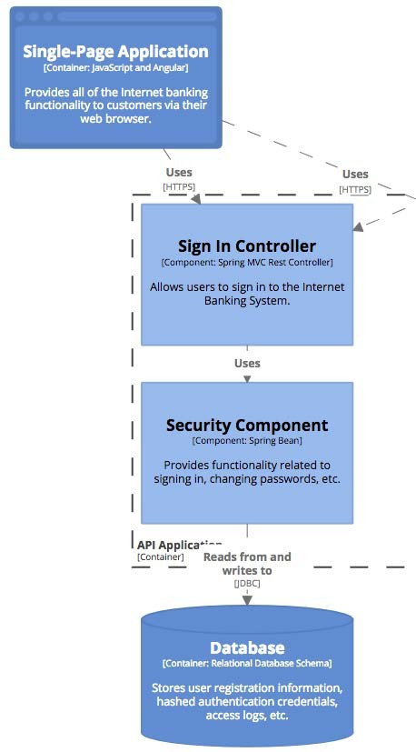
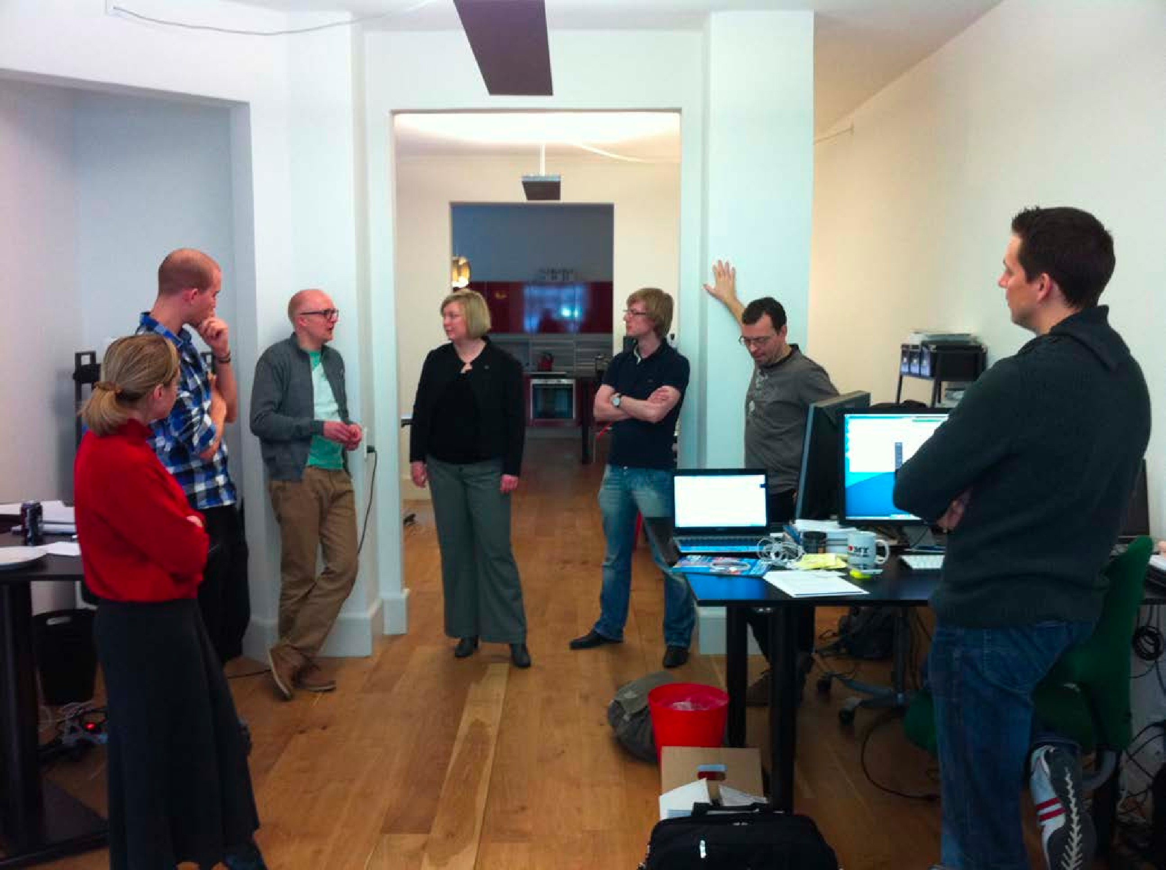
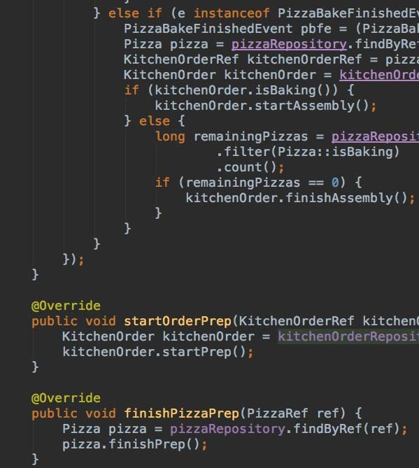
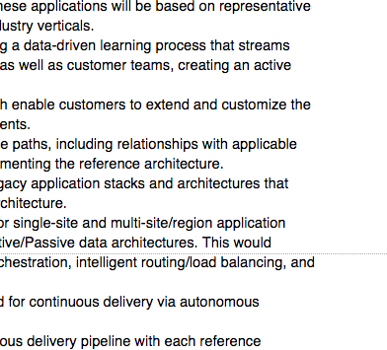
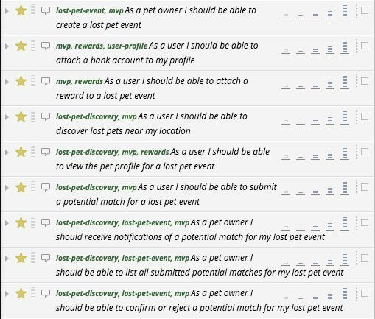
it is used everywhere
Verbal Discussions
Diagrams
Code
Documents
User Stories

Slide 6
antipatterns to avoid
氝ਮ
" " "
?!?!?!?
$ $ $
Business Specifies Language, Poor Fit for Development

Slide 7

antipatterns to avoid
氝ਮ
氝ਮ
" " "
" " "
?!?!?!?
πελάτης
$ $ $
Development Uses a Completely Different Language
$ $ $
Business Specifies Language, Poor Fit for Development

Slide 8
pattern to embrace
" $
" $
ग्राहक
ग्राहक
" $
Everyone Collaborates
ग्राहक

Slide 9
where it exists
$ग्राहक
$氝ਮ
"
" $
" $
"
" $
" $
ग्राहक
氝ਮ
ग्राहक
氝ਮ
$πελάτης
$πελάτης
$πελάτης
"
"
"
Bounded Contexts

Slide 10
thank you!
Domain-Driven Design and Event-Driven Microservices
Matt Stine (@mstine) http://mattstine.com matt.stine@gmail.com

Slide 11
DDD 101: strategic design
Domain-Driven Design and Event-Driven Microservices
Matt Stine (@mstine) http://mattstine.com matt.stine@gmail.com

Slide 12
Agenda
■
What is Strategic Design?
Ubiquitous Language and Bounded Contexts
■
Subdomains
■
Bounded Contexts vs. Subdomains
Context Mapping
■
Context Mapping vs. Technical Architecture

Slide 13

Strategic Design - the view from 35,000 FEET

Slide 14
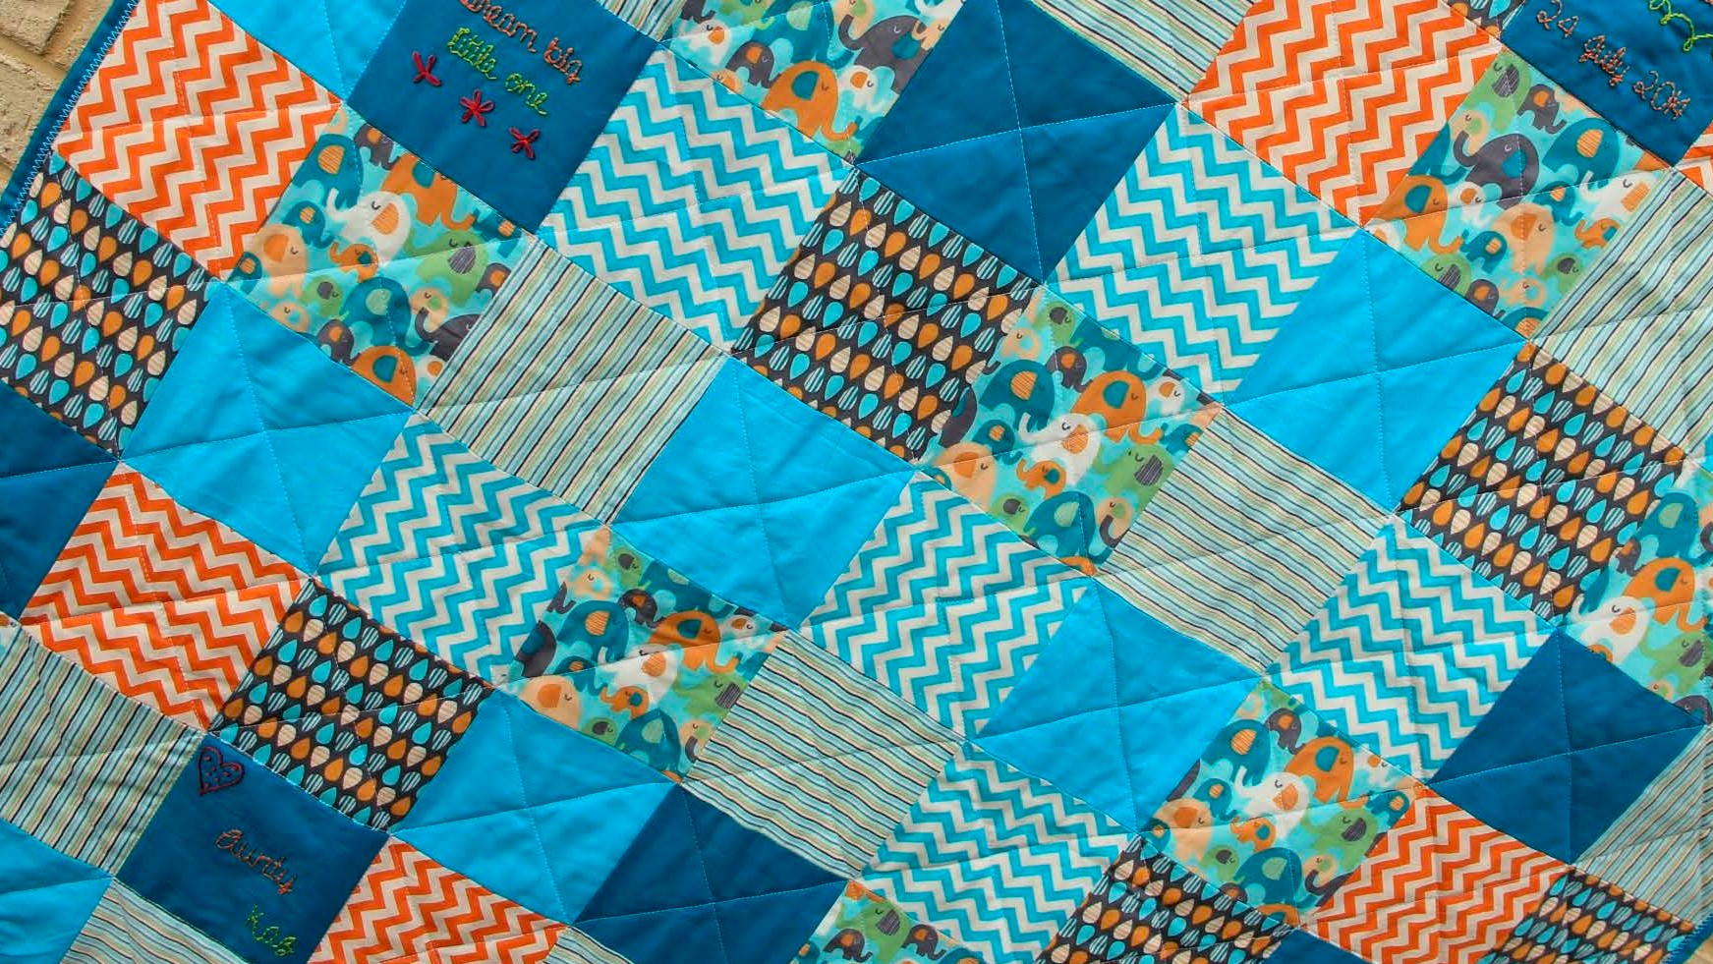


finding THE
SEAMS

Slide 15
integrating the
PIECES
"ग्राहक
"氝ਮ
!
! "
! "
!
! "
! "
ग्राहक
氝ਮ
ग्राहक
氝ਮ
"πελάτης "πελάτης "πελάτης
!
!
!

Slide 16
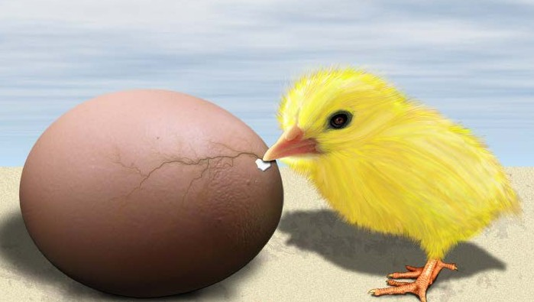
what came first?
Ubiquitous Language
Bounded Context

Slide 17
global ubiquitous language?
"ग्राहक
"氝ਮ
!
! "
! "
!
! "
! "
ग्राहक
氝ਮ
ग्राहक
氝ਮ
"πελάτης "πελάτης "πελάτης
!
!
!

Slide 18
essential differences
An Order is something for which we process Payments!
An Order is something we ship to the appropriate address!
! "
! "
! "
! "
! "
! "
An Order is something we fulfill from warehouse inventory!
! "
! "
! "

Slide 19
Bound and embrace the differences
An Order is something for which we process Payments!
An Order is something we ship to the appropriate address!
! "
! "
! "
! "
! "
! "
An Order is something we fulfill from warehouse inventory!
! "
! "
PAYMENTS CONTExT
shipping context
! "
Fulfillment context

Slide 20
the language is scoped
Undefined
Internally Consistent
Internally Consistent
PAYMENTS CONTExT
shipping context
Internally Consistent
Undefined
Undefined
Fulfillment context

Slide 21
A Subdomain is a single, logical domain model that is a sub-part of your overall business domain.

Slide 22
subdomains
■
Core
strategic, competitive differentiators
Generic
necessary, but available as COTS/SaaS (e.g. HR software)
■
Supporting
necessary, but requires custom software development

Slide 23
Focus your DDD effort only on Core Subdomains.

Slide 24
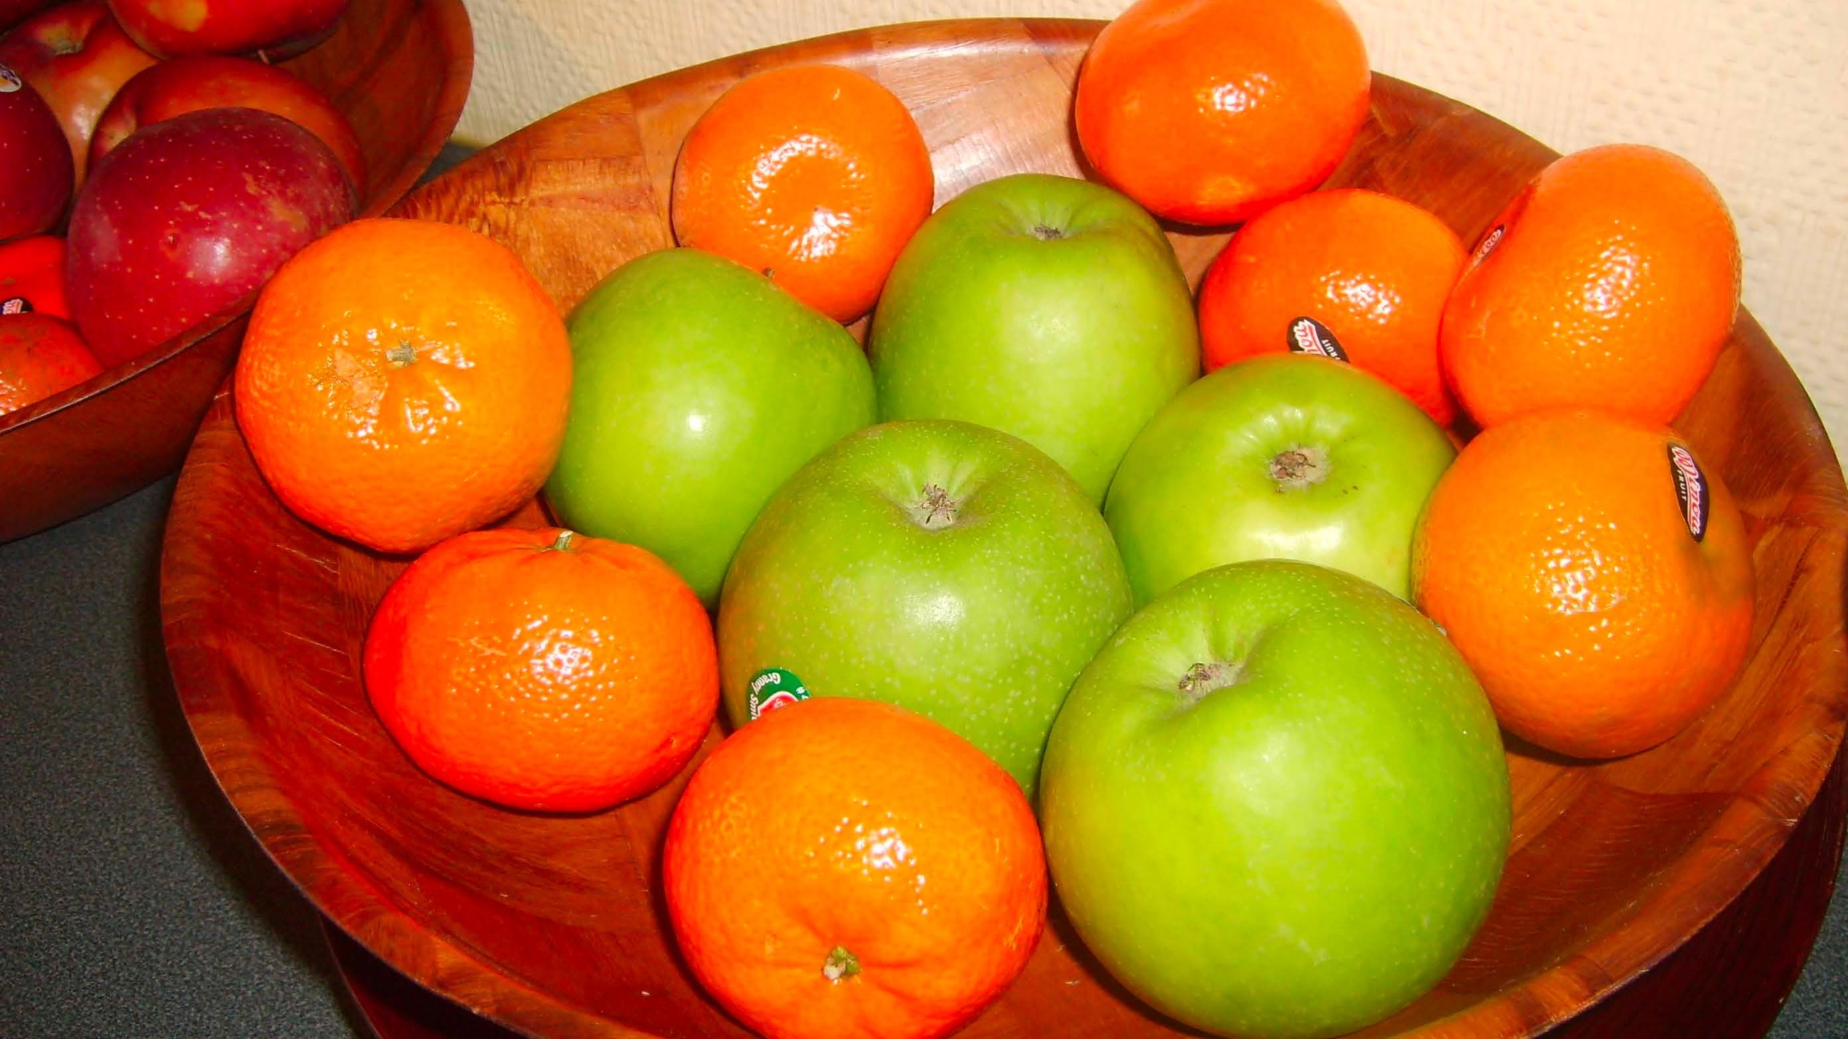




Are subdomains the same as
bounded contexts?

Slide 25
ideal:
1 Bounded context : 1 subdomain

Slide 26
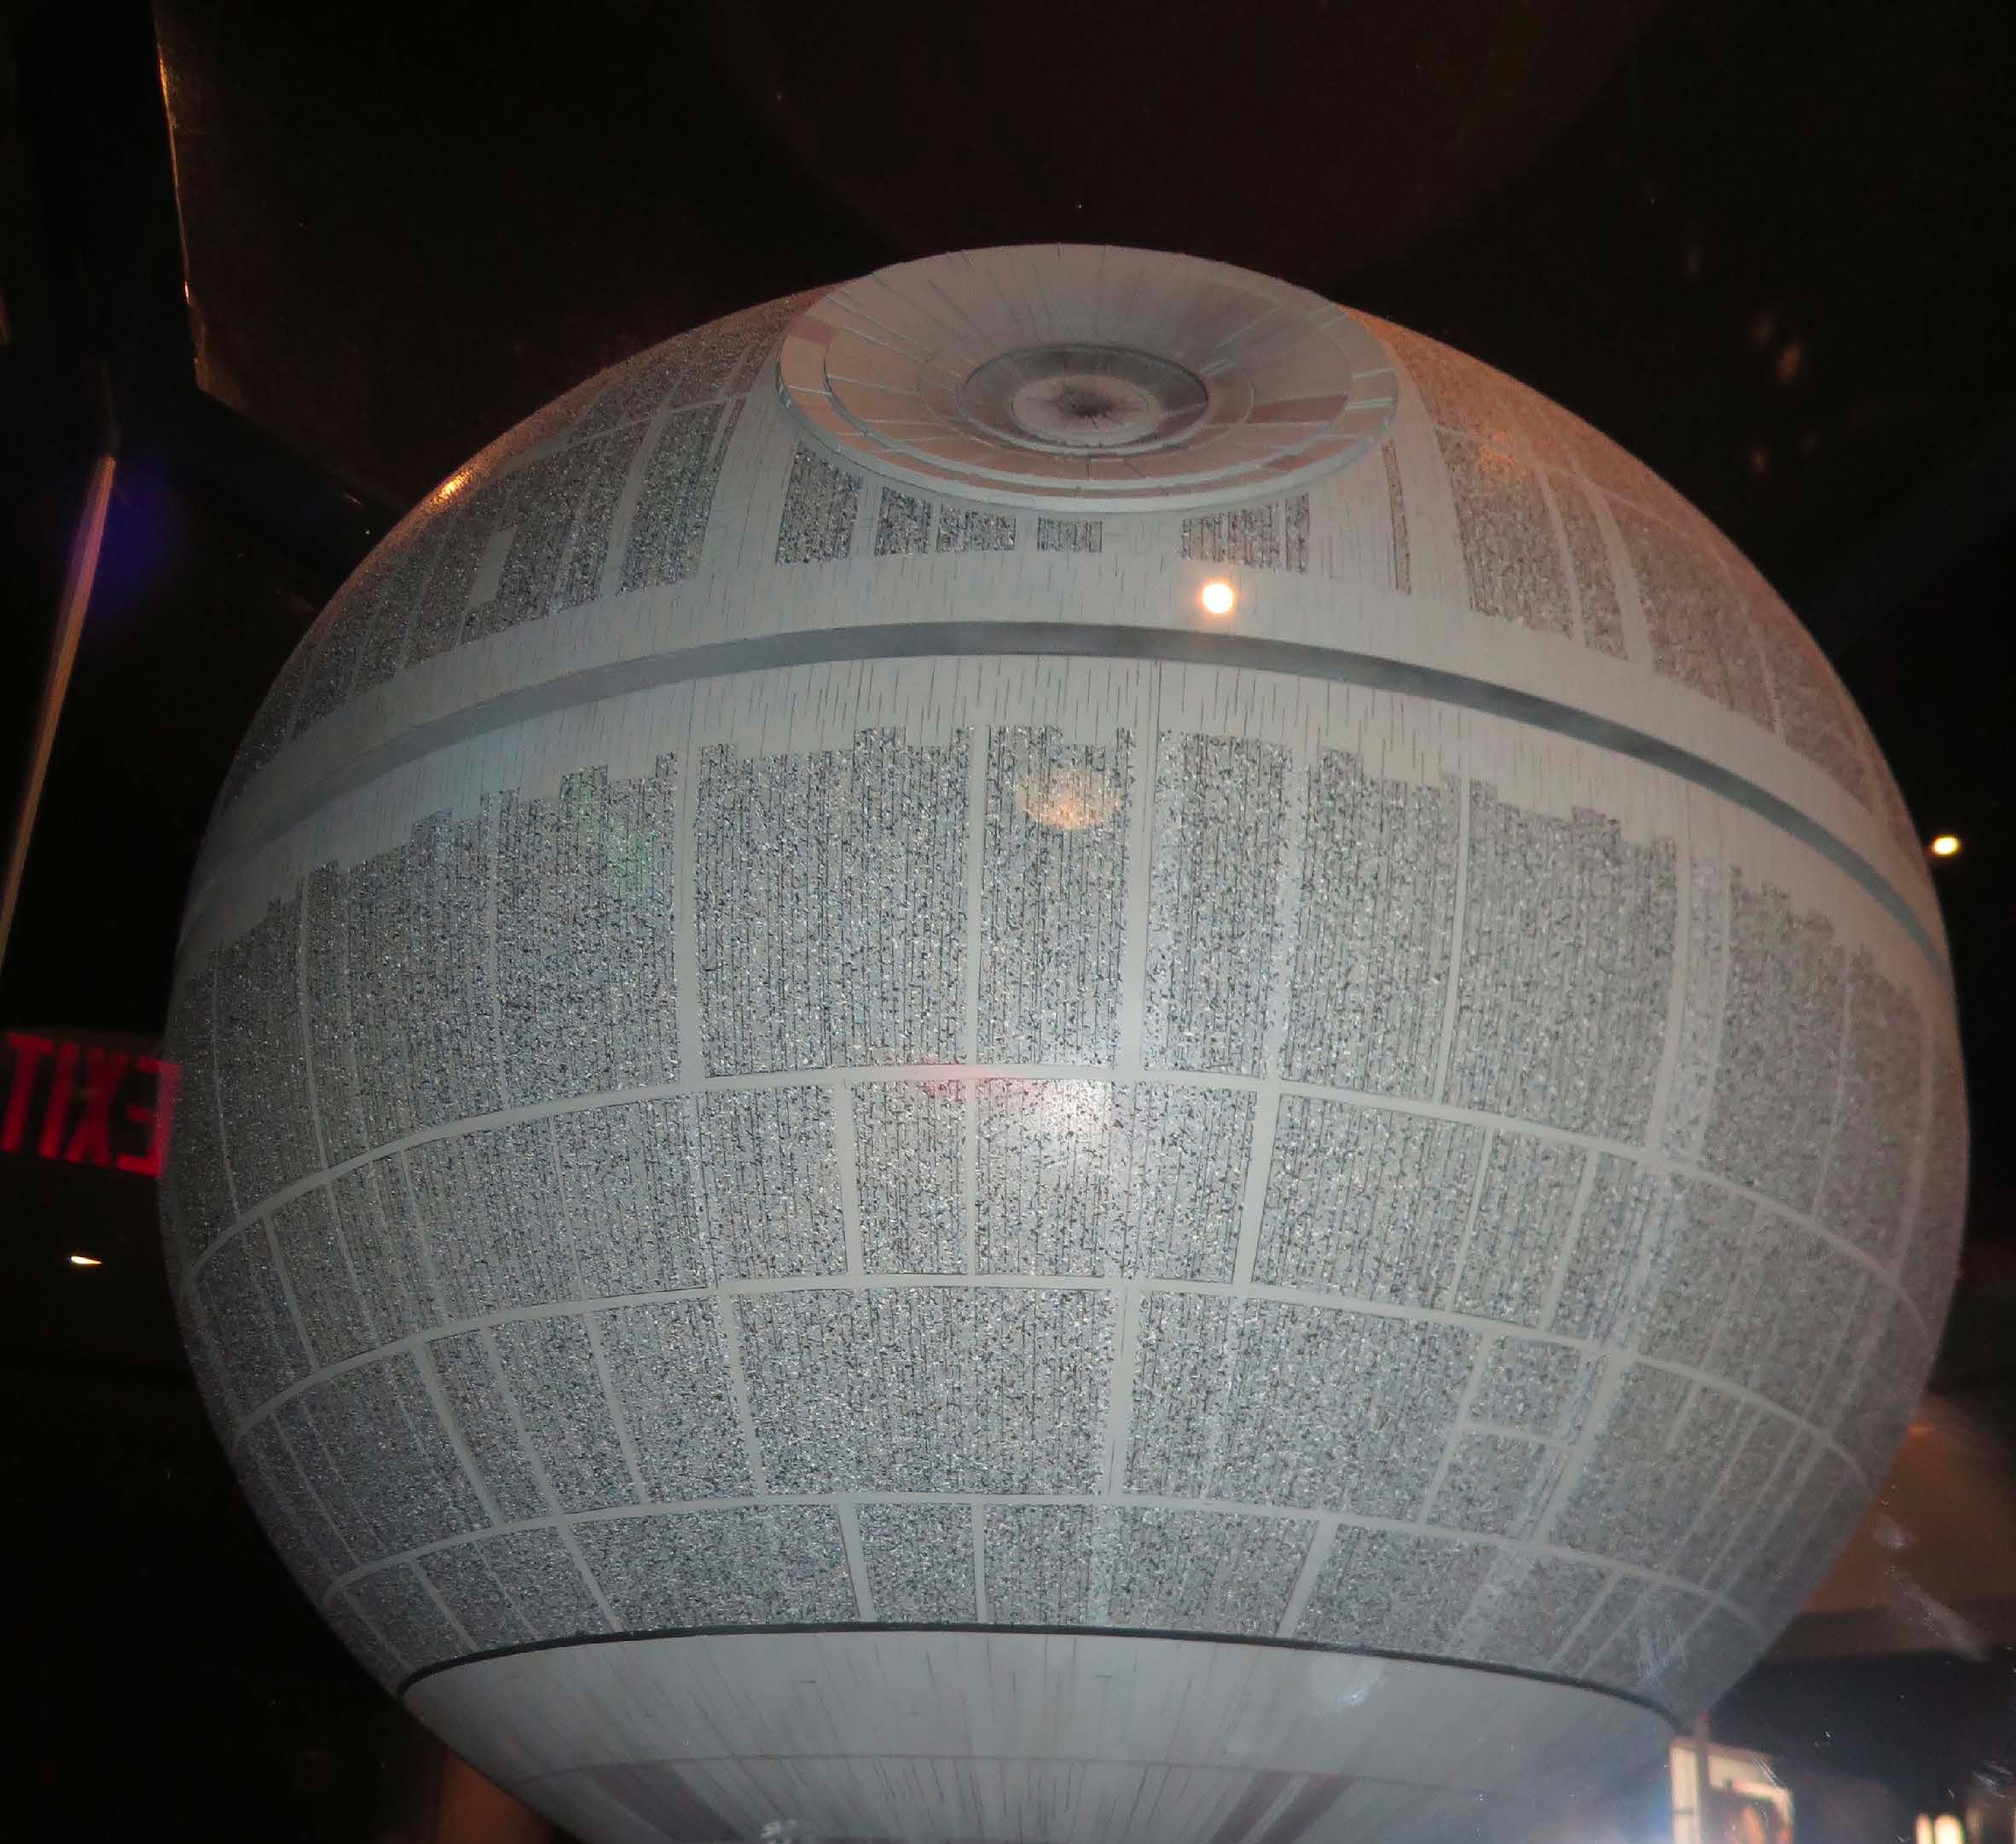





LEGACY SYSTEMS
can blur
the lines

Slide 27
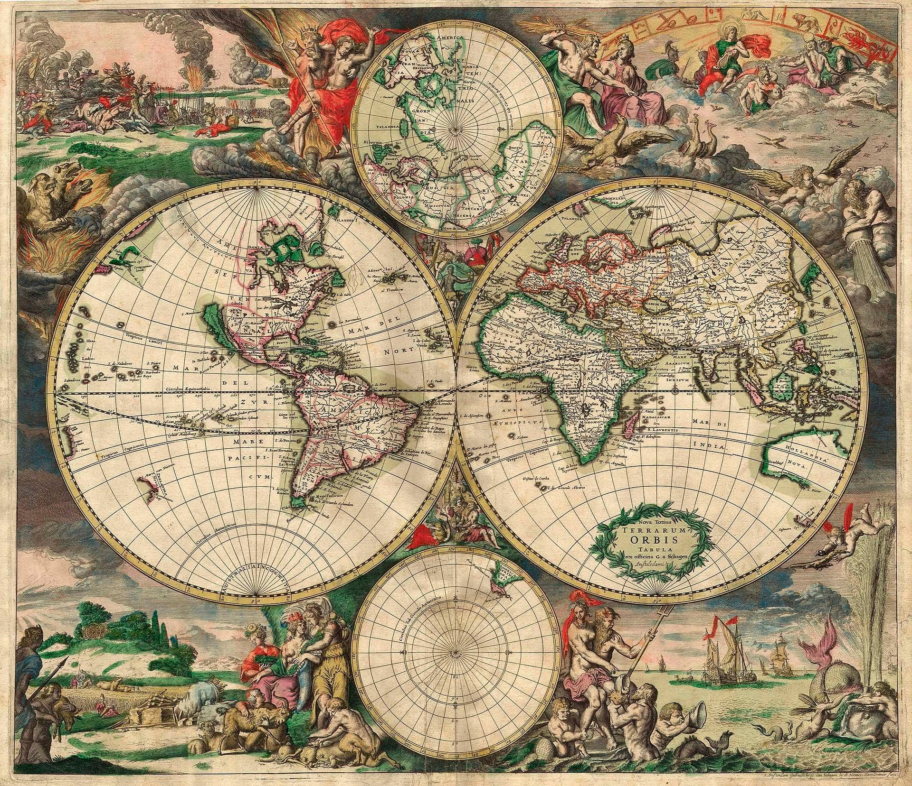
context mapping

Slide 28
connecting the contexts
"ग्राहक
"氝ਮ
!
! "
! "
!
! "
! "
ग्राहक
氝ਮ
ग्राहक
氝ਮ
"πελάτης "πελάτης "πελάτης
!
!
!

Slide 29
We define mappings on the basis of language.

Slide 30
partnership
!" ग्राहक
!"πελάτης

Slide 31
Shared Kernel
!" ग्राहक
氝ਮ
!"
πελάτης

Slide 32
Customer-supplier
!" ग्राहक
Upstream
!"πελάτης
Downstream

Slide 33
Conformist
Upstream
!"
Downstream
!"
氝ਮ
氝ਮ

Slide 34
anticorruption layer
!" ग्राहक
Upstream
!"πελάτης
ACL
Downstream

Slide 35
open host service
!" ग्राहक
Upstream
!"πελάτης
OHS
Downstream
Think API!

Slide 36
published language
!" ग्राहक
Upstream
!"πελάτης
PL
Downstream
Think API!

Slide 37
separate ways
!" ग्राहक
!"πελάτης

Slide 38
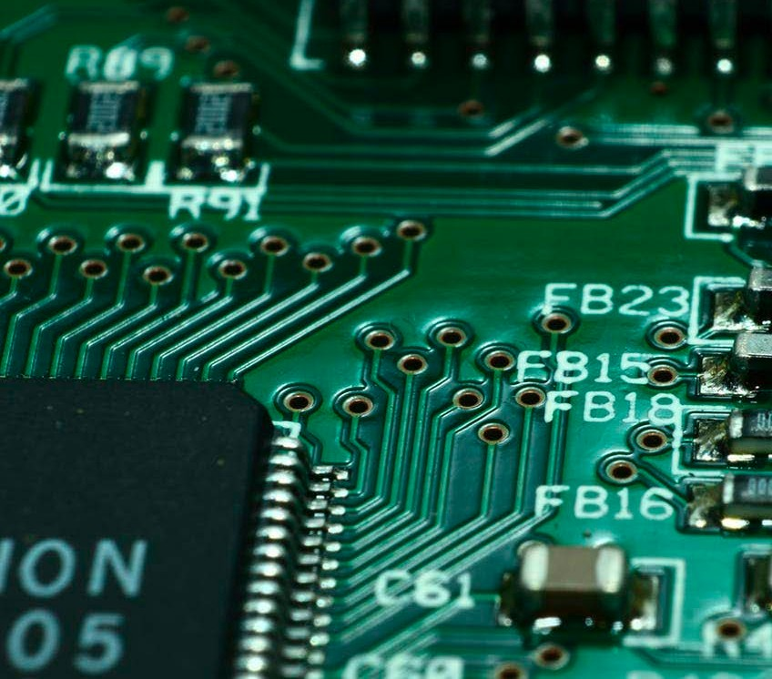
context mapping vs. technical
architecture

Slide 39
RESTful hTTp
RESTful HTTP
OHS
ACL
!"
POST GET DELETE PUT
!"
ग्राहक
πελάτης

Slide 40

messaging
Service Context
Client Context
RESTful COMMAND
OHS
ACL
!" ग्राहक
!"πελάτης
aggregate
aggregate
domain event
Messaging Transport

Slide 41
thank you!
Domain-Driven Design and Event-Driven Microservices
Matt Stine (@mstine) http://mattstine.com matt.stine@gmail.com

Slide 42
DDD 101: TACTICAL design
Domain-Driven Design and Event-Driven Microservices
Matt Stine (@mstine) http://mattstine.com matt.stine@gmail.com

Slide 43
agenda
What is Tactical Design?
Aggregates
Entities vs. Value Objects
■
Aggregates Revisited
Domain Events
Domain Services
■
Application Services

Slide 44
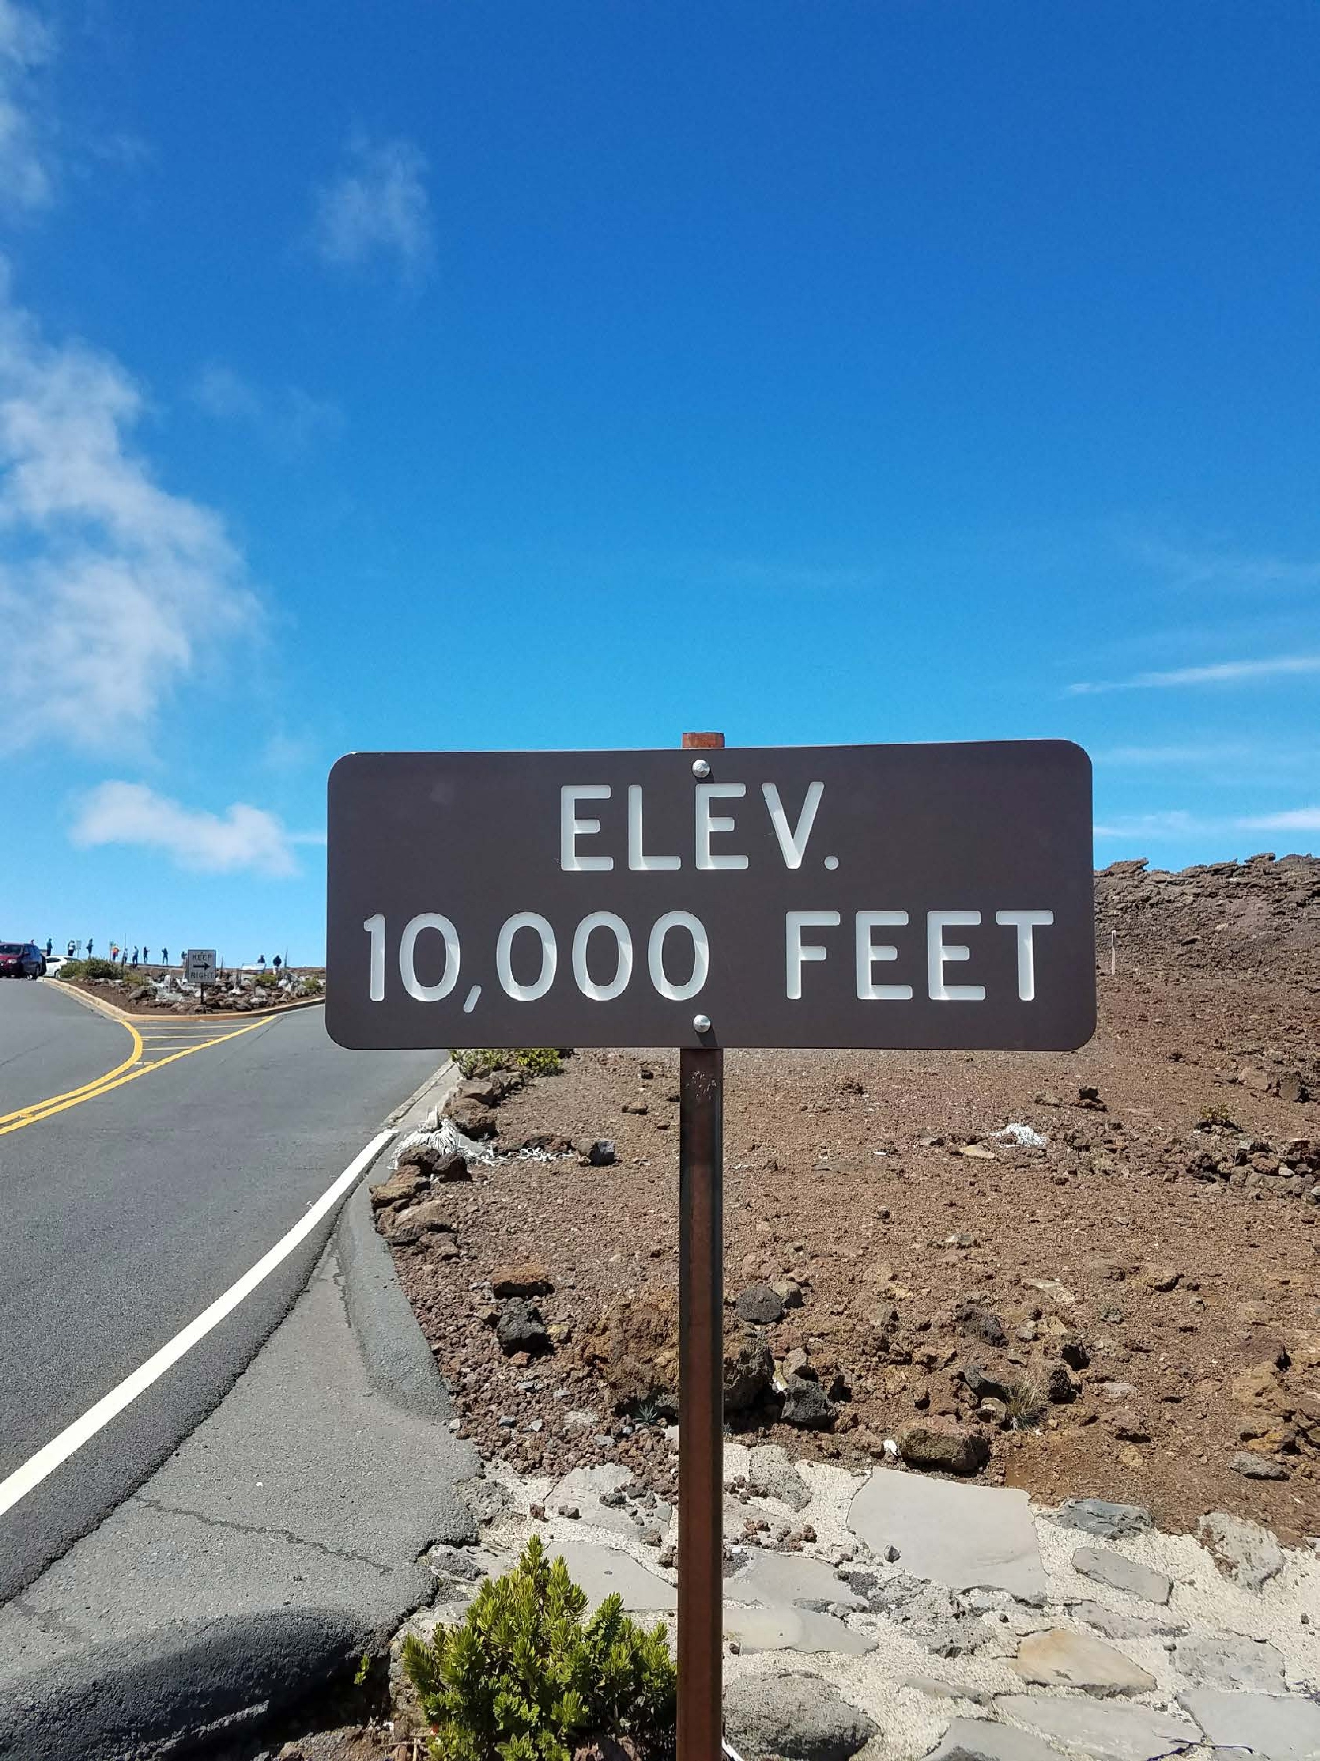
Tactical DESIGN?
Now it’s time to start speaking the Ubiquitous Language within each Bounded Context.
■
Business Invariants
Policies
■
Transactions
■
State
Persistence

Slide 45
the central concept
aggregate

Slide 46
the central concept
A cluster of objects treated as a single unit.
aggregate

Slide 47
the central concept
A cluster of objects treated as a single unit.
aggregate
Only accessed through its Root Entity.

Slide 48
the central concept
A cluster of objects treated as a single unit.
aggregate
Only accessed through its Root Entity.
Responsible for maintaining any/all business invariants.

Slide 49
the central concept
A cluster of objects treated as a single unit.
aggregate
Only accessed through its Root Entity.
The atomic unit for any transactional
behavior.
Responsible for maintaining any/all business invariants.

